Slide 1
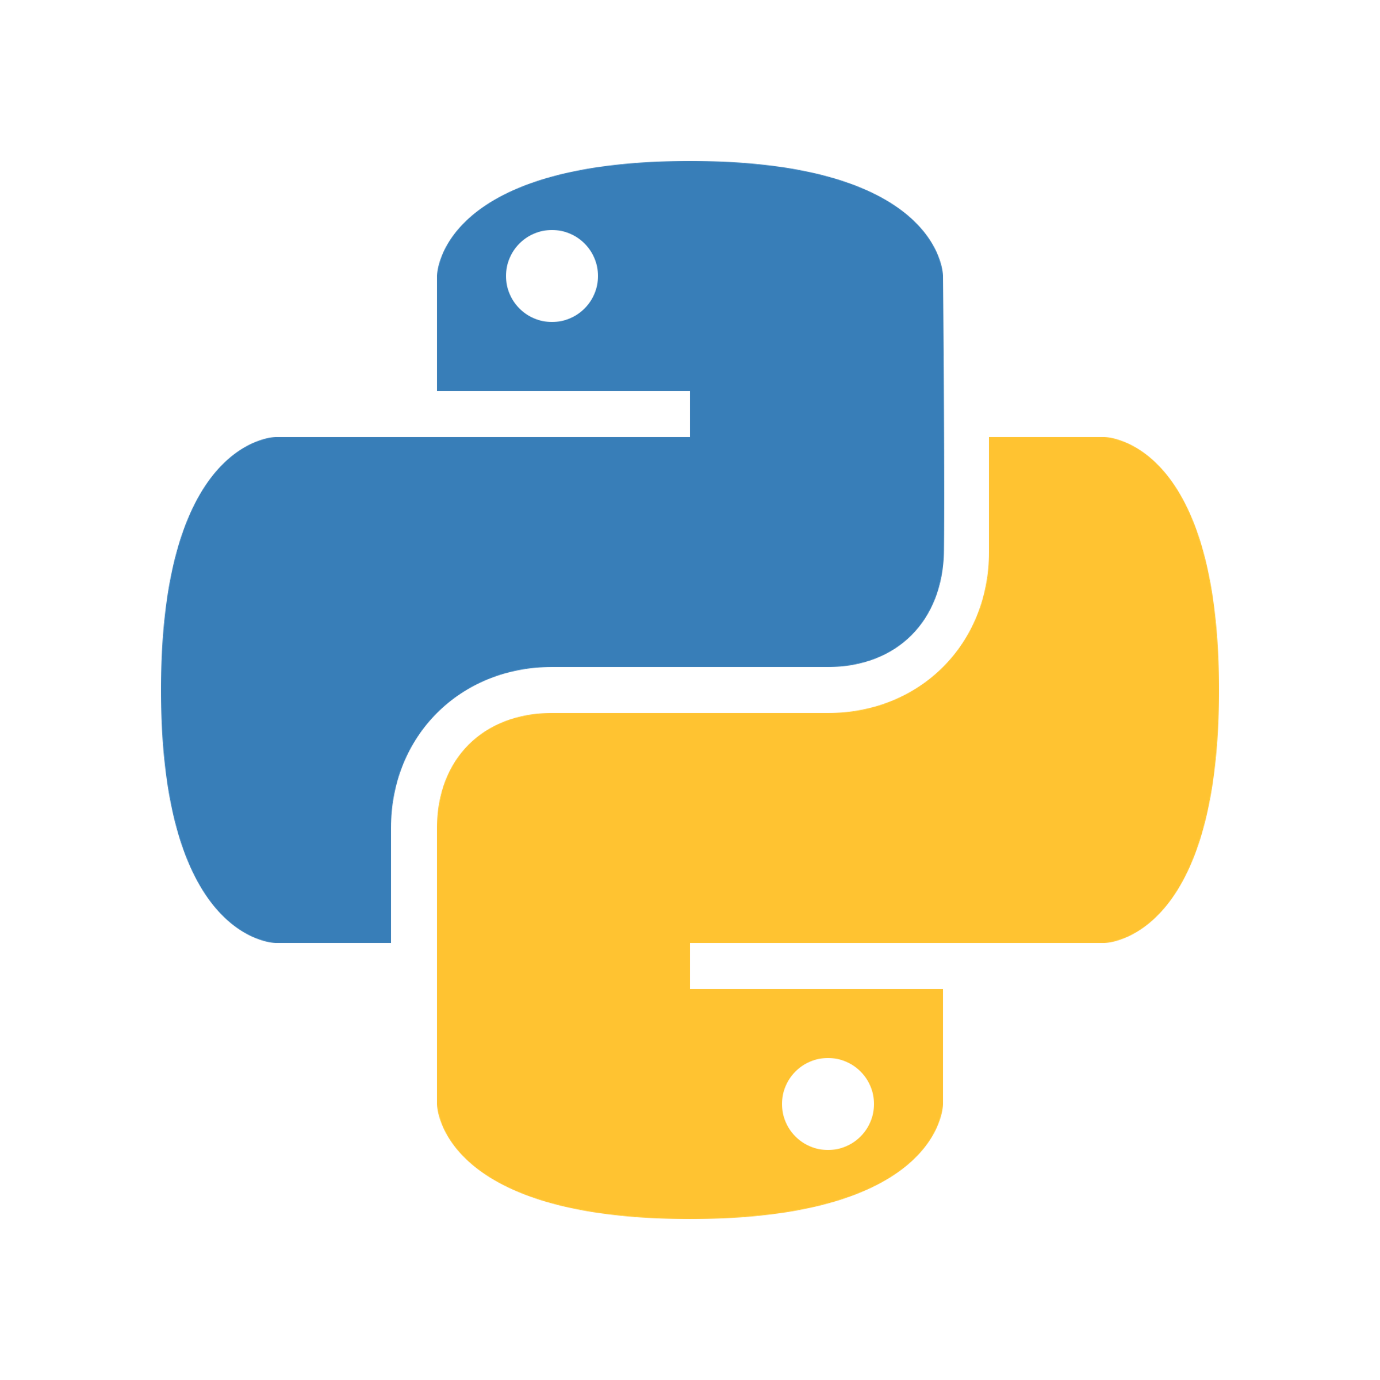
Python programming and data visualization for beginners Dr Joel Martin

Slide 2
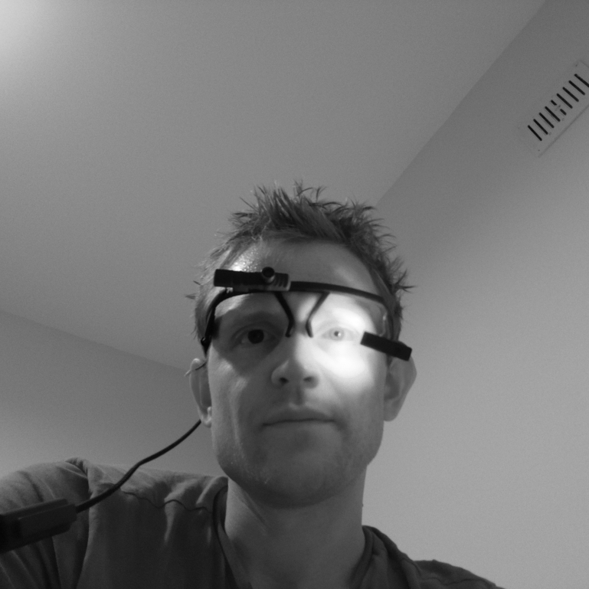

Joel Martin
Postdoctoral Research Associate
University of York
@jtmbeta | GitHub / Twitter
1 – From Middlesbrough
2 – BSc Psychology and Biology (Liverpool John Moores University, 2006 – 2009)
3 – MSc Psychological Research (Bangor Universiry, 2011 – 2013)
4 – PhD Psychology (Swansea University, 2013 – 2018)
5 – Research Support Specialist (Mind’s Eye Research, 2018 – 2020)
6 – Postdoctoral Research Assistant (University of Oxford, 2020 – 2021)
7 – Postdoctoral Research Associate (University of York, 2021 – present)
1
7
2
3
4
6
5

Slide 3
Course outline
Week 0 – Introduction to the Python programming language
Week 1 – Syntax, data types, and built-ins
Week 2 – Logic, operators, control statements, functions
Week 3 – Imports, the standard library, third-party libraries
Week 4 – An introduction to data visualisation
Week 5 – numpy, matplotlib, pandas
Week 6 – Locating and visualising interesting data
Week 7 – Presentations and future direction

Slide 4
Week 0
Interpreted language
Parser – tokens – lexical analyszer
Structure of a program – logical lines
An introduction to the Python programming language
What is a computer?
What is a programming language?
What is Python?
What can I do with Python?
How can I install Python?
How can I work with Python?

Slide 5
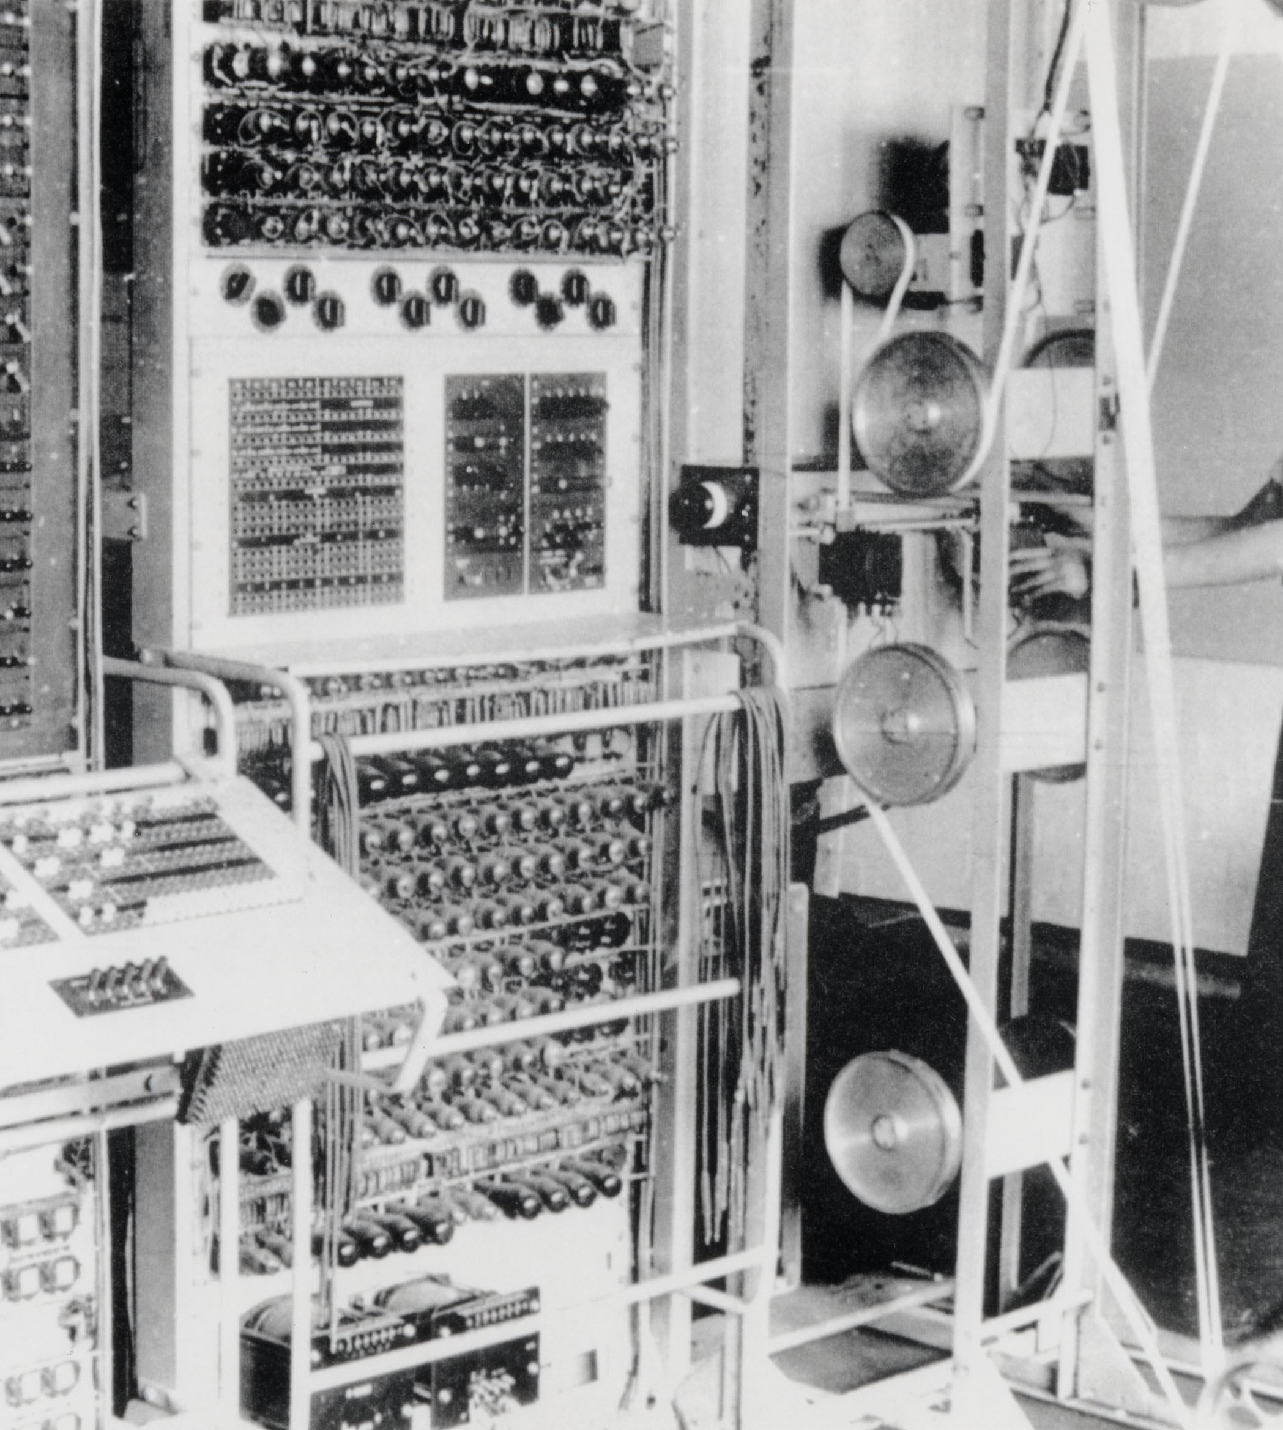
Computers
What are they?
Computer
noun
An electronic device for storing and processing data, typically in binary form, according to instructions given to it in a variable program.
Pictured right: The Colossus computer, regarded as the World’s first programmable, electronic, digital computer, was designed by Tommy Flowers at Bletchley Park to decode German messages towards the end of World War II.
Notes:
Colossus was a set of computers developed by British codebreakers in the years 1943–1945^{[1]} to help in the cryptanalysis of the Lorenz cipher. Colossus used thermionic valves (vacuum tubes) to perform Boolean and counting operations. Colossus is thus regarded^{[2]} as the world's first programmable, electronic, digital computer, although it was programmed by switches and plugs and not by a stored program.^{[3]}

Slide 6
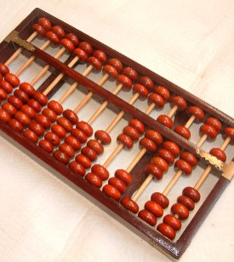
Computers
A brief history
The abacus – a counting tool used by ancient civilizations (2700–2300 BC) prior to the Hindu-Arabic number system
Comprised of small objects representing digits (e.g., wooden beads, seashells, pebbles) threaded onto wire or wooden rods
Mathematical operations are performed by changing the positions of the objects

Slide 7
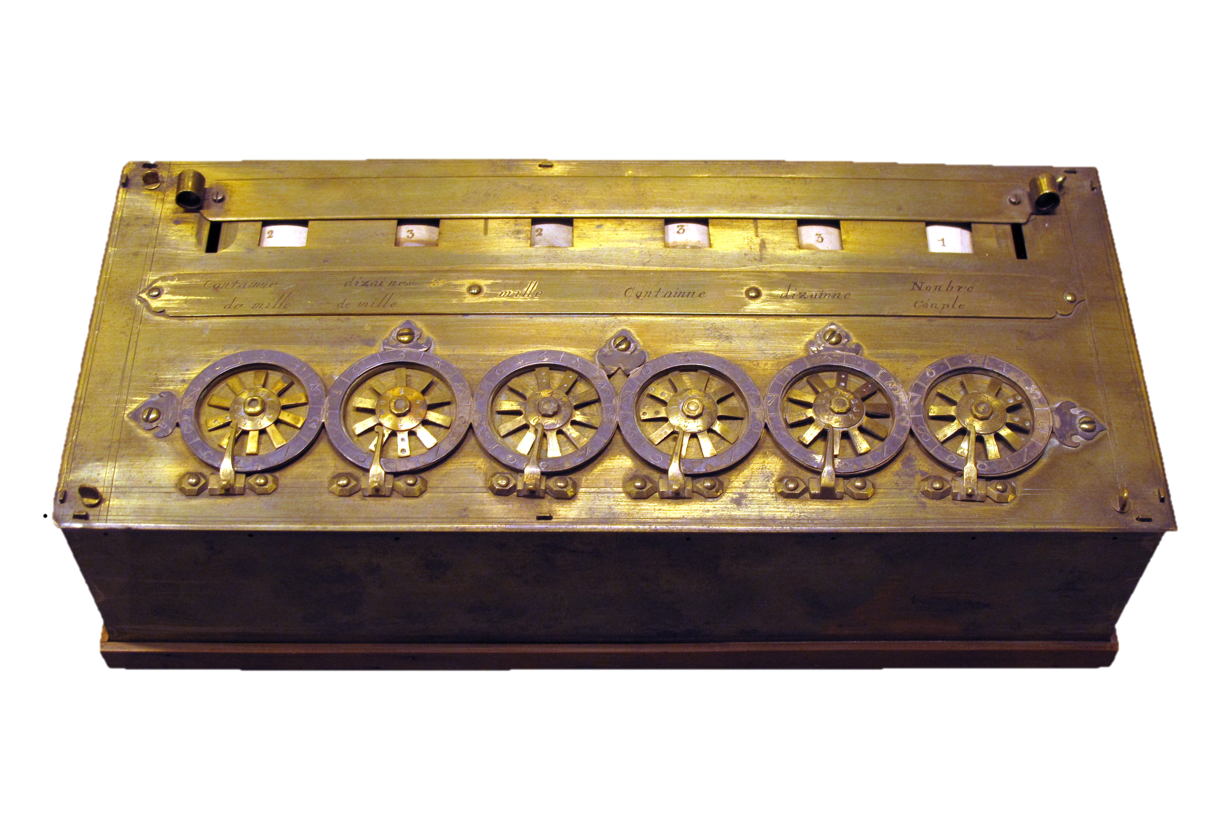
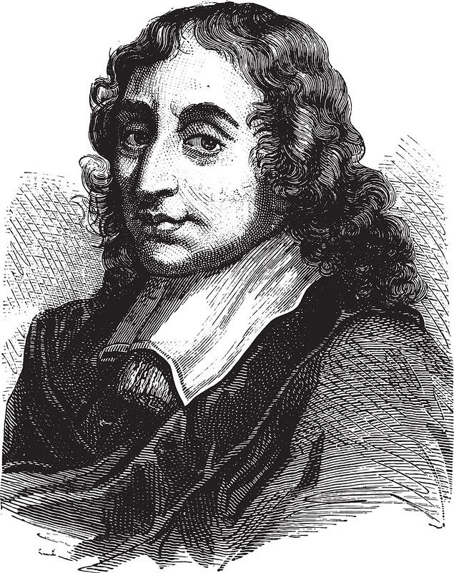
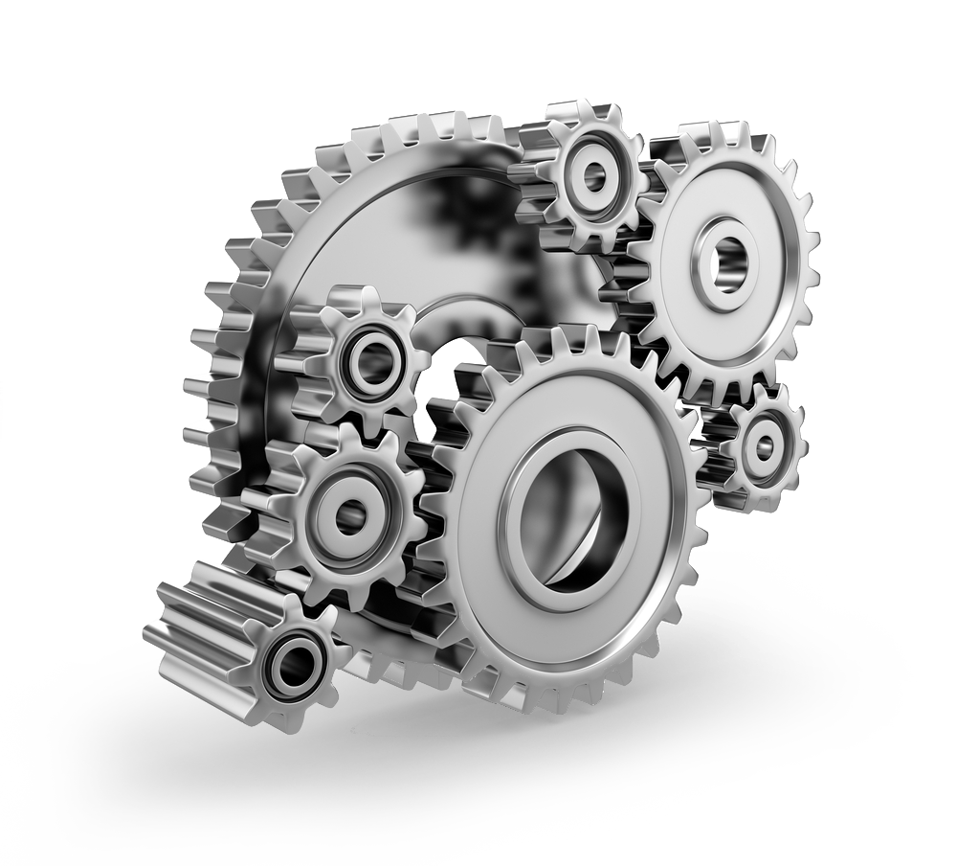
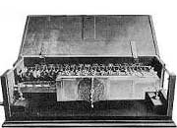
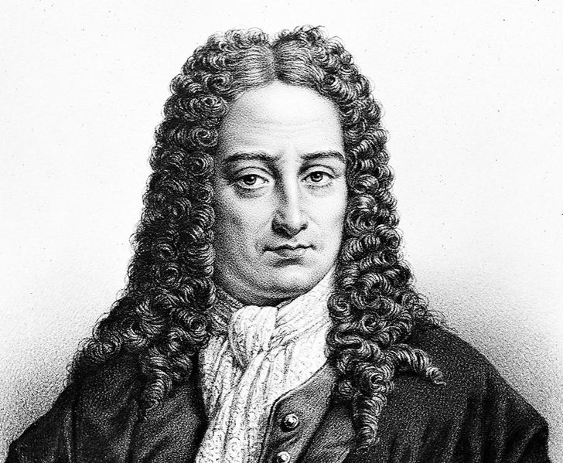
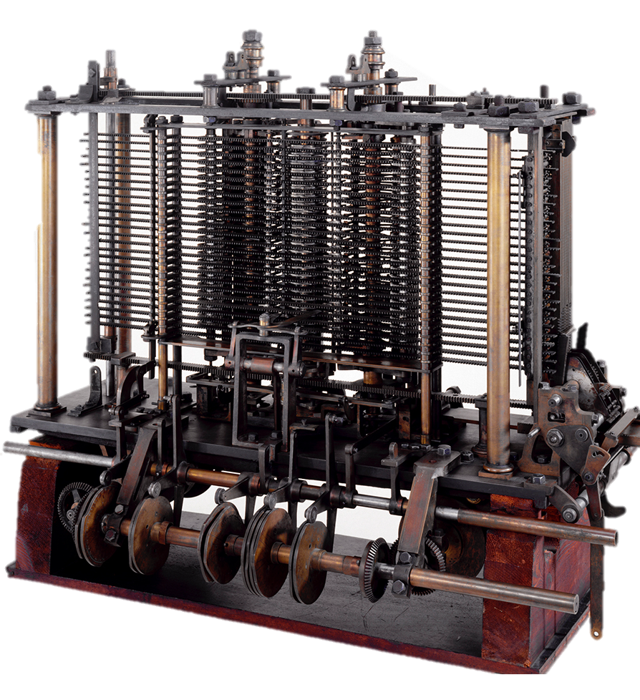
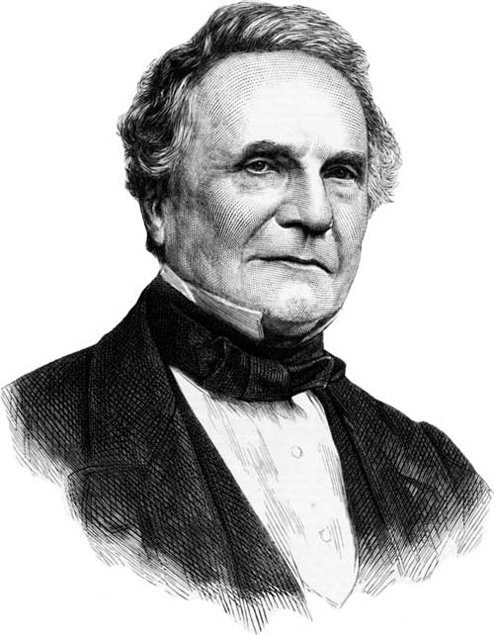
Computers
A brief history
Gear technology led to new inventions where data are represented through gear positions
Pictured right (top to bottom):
Blaise Pascal (1623-1662) and his mechanical calculator
Gottfried Leibniz (1646-1716) and his stepped reckoner
Charles Babbage (1792-1781) and his difference engine

Slide 8
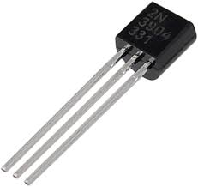
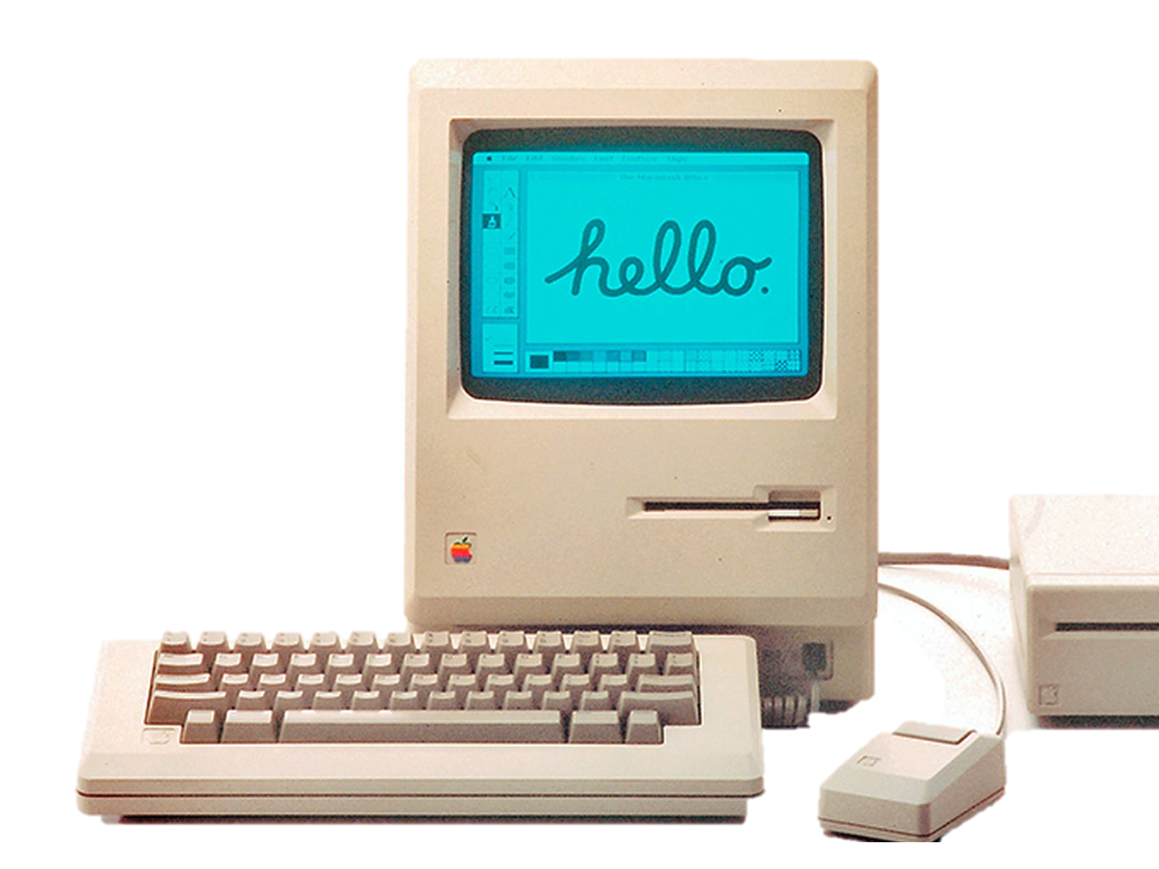
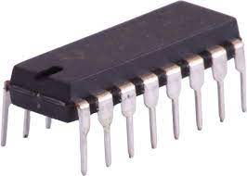
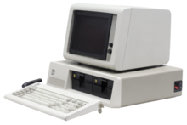





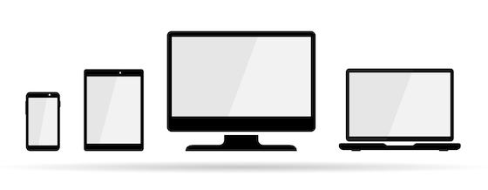
Computers
A brief history
1947: Invention of the transistor and subsequent development of integrated circuits gives rise to modern computing machines
1976: Steve Jobs and Stephen Wozniak build first commercially viable home computer
1981: IBM introduce first desktop computer
1983: Tim Berners-Lee invents the World Wide Web
1990 - present:
Search engines such as Google, AOL, Ask Jeeves and Duck Duck Go make the web more accessible
Computers become smaller, more powerful and widely available
Many people use computers and the internet every day

Slide 9
Programming languages
What are they?
0 1 0 0 1 0 0 0 0 1 1 0 0 1 0 1 0 1 1 0 1 1 0 0 0 1 1 0 1 1 0 0 0 1 1 0 1 1 1 1 0 0 1 0 0 0 0 0 0 1 0 1 0 1 1 1 0 1 1 0 1 1 1 1 0 1 1 1 0 0 1 0 0 1 1 0 1 1 0 0 0 1 1 0 0 1 0 0 0 0 1 0 0 0 0 1
Hello
world!
SECTION .data
Msg: db “Hello world!”, 10
Len: equ $-Msg
SECTON .text
global _start
_start:
mov eax,4
mov ebx,1
mov ecx,Msg
mov edx,Len
int 80H
mov eax,1
mov ebx,0
int 80H
A set of instructions for interacting with and controlling a computer
Because computers can’t speak human languages!
Instead, they represent everything with bits of information:
1 or 0
True or False
Three levels of programming language:
Machine language (e.g., binary)
Assembly language (e.g., x86 Assembly)
High-level languages (e.g., Python)
print(“Hello world!”)
Notes:
What is a Programming Language
A programming language is a set of instructions that can be used to interact with and control a computer. These languages are used to design websites, create apps, develop operating systems, control spacecraft, and analyze data. Programming languages are necessary because computers can't understand English. Programming languages bridge this gap by helping programmers translate their commands into something that the computer can understand and execute.
Why can't computers understand Plain English?
When people communicate with a computer, it is important to be very specific about what they are asking the computer to do. Programming languages are a tool that allow them do just that. Often, English can be ambiguous and it can be hard for the computer to determine intent. Programmers use programming languages so that they can specify exactly what they want the computer to do.
How do computers think?
Computers are made of many tiny switches that can be either on or off. When a switch is on, it is represented by a 1. When it is off, it is represented by a 0. These 1s and 0s are called bits. Bits are the fundamental language of nearly all computers and every program must be translated into bits before it can be executed by the computer.
Machine language - the programmer writes each instruction in a numeric form the hardware can execute directly
Assembly language – programs can be written in a more human readable and less error-prone form
High level languages – programs are written in an abstracted form that does not depend on the specific hardware details of a computer

Slide 10
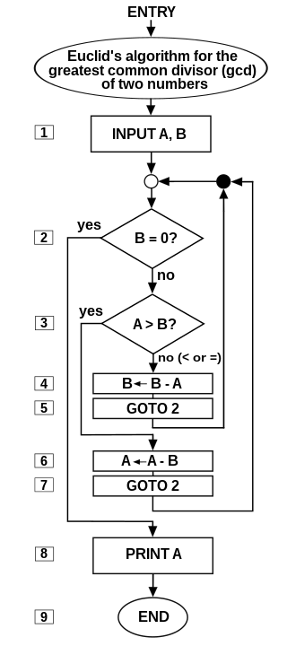
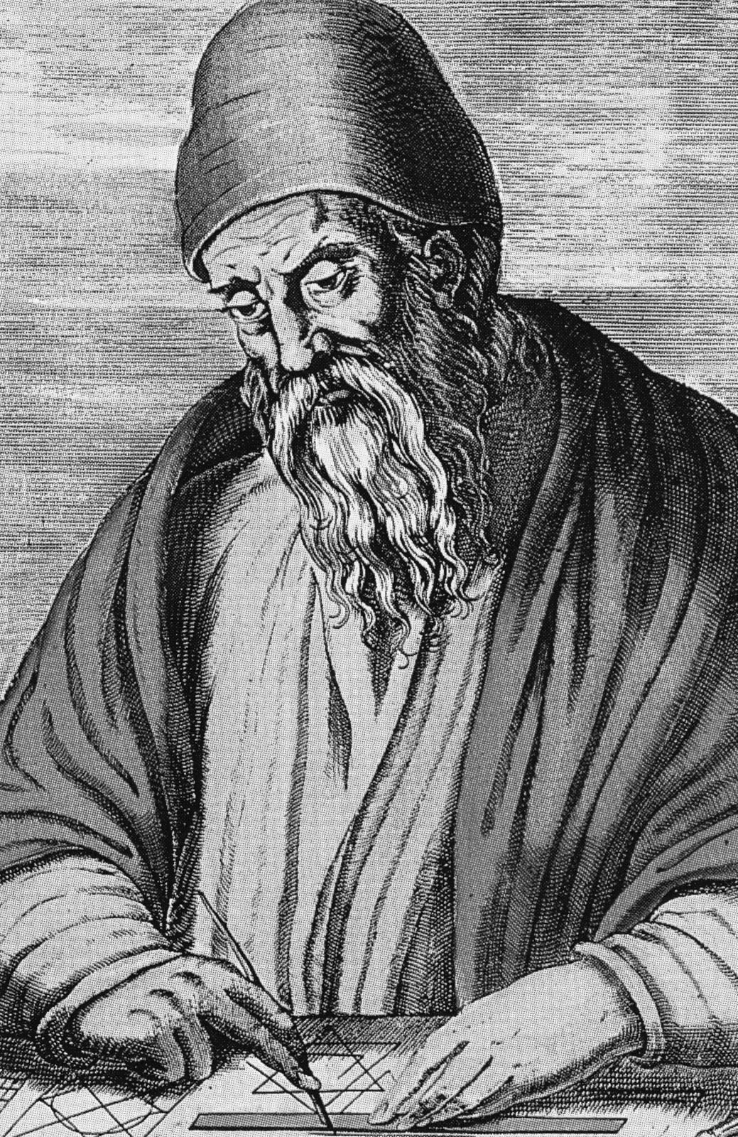
Programming languages
Algorithms
Algorithm
noun
A process or set of rules to be followed in calculations or other problem-solving operations, especially by a computer.
Algorithms are a fundamental concept in computer science and computer programming
Computer programs are representations of algorithms
Pictured right: The Ancient Greek mathematician, Euclid (c. 300 BCE), and his algorithm for finding the greatest common divisor of two numbers
Euclid was one of the greatest mathematicians of antiquity and his algorithm is still widely used today.

Slide 11
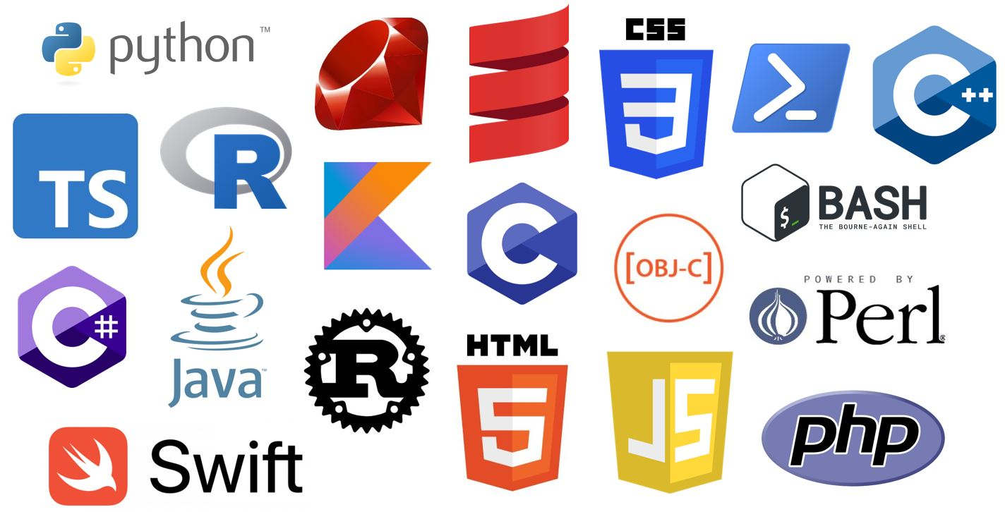
Programming languages
How many are there?
Lots!
Various paradigms:
Procedural
Functional
Scripting
Logic
Object oriented
Pictured right are the 20 most popular programming languages
Notes:
What is a Programming Language
A programming language is a set of instructions that can be used to interact with and control a computer. These languages are used to design websites, create apps, develop operating systems, control spacecraft, and analyze data. Programming languages are necessary because computers can't understand Engish. Programming languages bridge this gap by helping programmers translate their commands into something that the computer can understand and execute.
Why can't computers understand Plain English?
When people communicate with a computer, it is important to be very specific about what they are asking the computer to do. Programming languages are a tool that allow them do just that. Often, English can be ambiguous and it can be hard for the computer to determine intent. Programmers use programming languages so that they can specify exactly what they want the computer to do.
How do computers think?
Computers are made of many tiny switches that can be either on or off. When a switch is on, it is represented by a 1. When it is off, it is represented by a 0. These 1s and 0s are called bits. Bits are the fundamental language of nearly all computers and every program must be translated into bits before it can be executed by the computer.
Machine language - the programmer writes each instruction in a numeric form the hardware can execute directly
Assembly language – programs can be written in a more human readable and less error-prone form
High level languages – programs are written in an abstracted form that does not depend on the specific hardware details of a computer

Slide 12

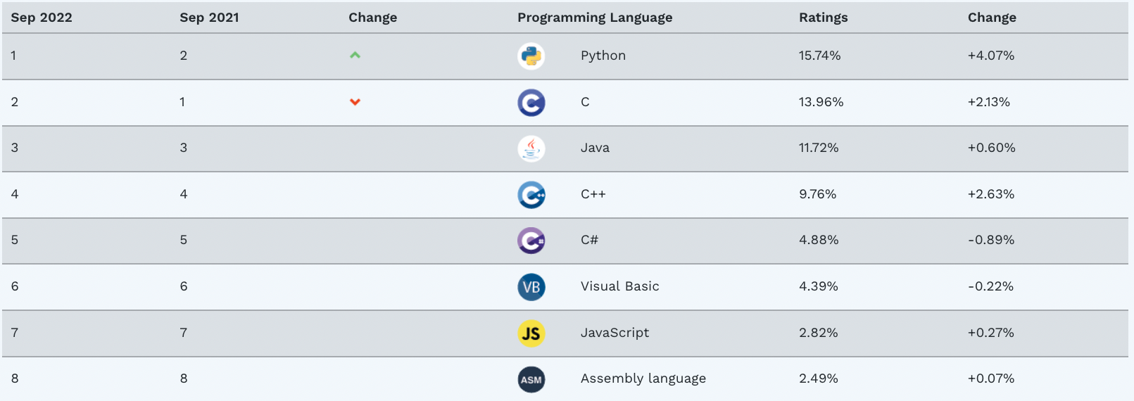
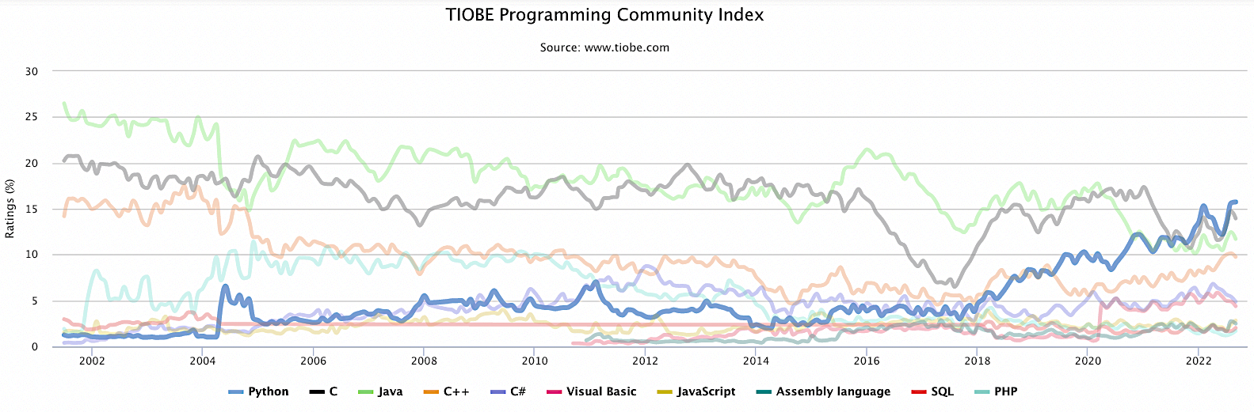
Programming languages
Which is best?
There is no “best” programming language. All have their strengths and weaknesses
TIOBE – An index of software quality and popularity
Python’s ratings have climbed sharply since 2018
Currently number 1

Slide 13
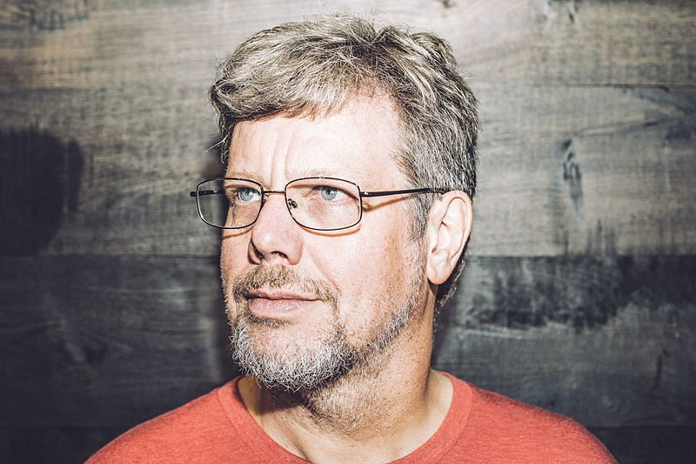
Python
What is it?
An interpreted, object-oriented, high-level programming language with dynamic semantics
Conceived in the late 1980s by Guido van Rossum (principal author)
Named after Monty Python’s Flying Circus (Guido must have a sense of humor!)
Current version is 3.10
Portrait of Guido Van Rossum at the Dropbox headquarters in 2014. Taken by San Francisco based photographer Dan Stroud. Licensed under CC BY-SA 4.0.

Slide 14
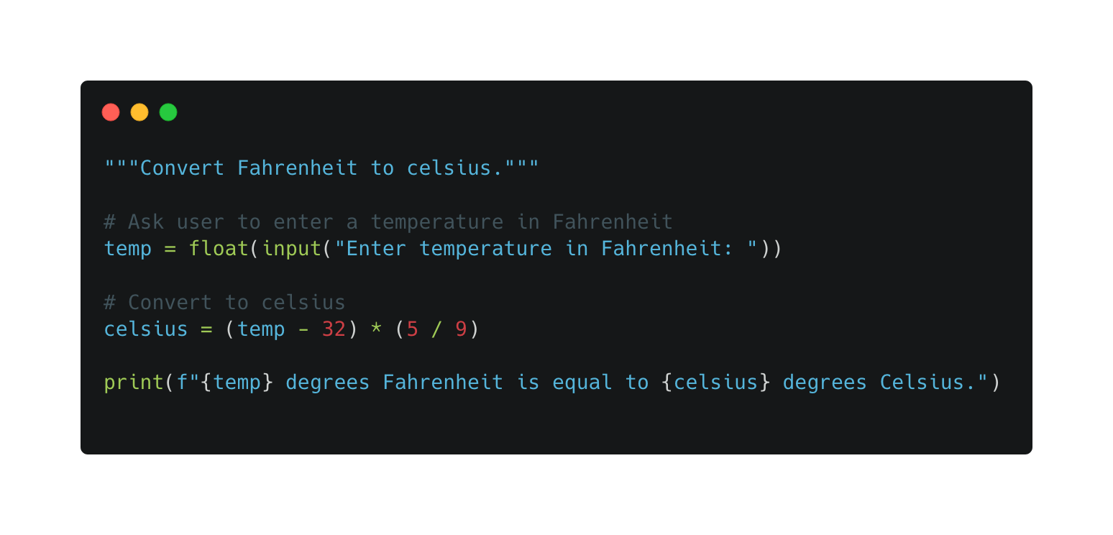
Python
Example programs
00_fahreneit_to_celsius.py
Request input from user in Fahrenheit, perform Celsius conversion, report the result

Slide 15
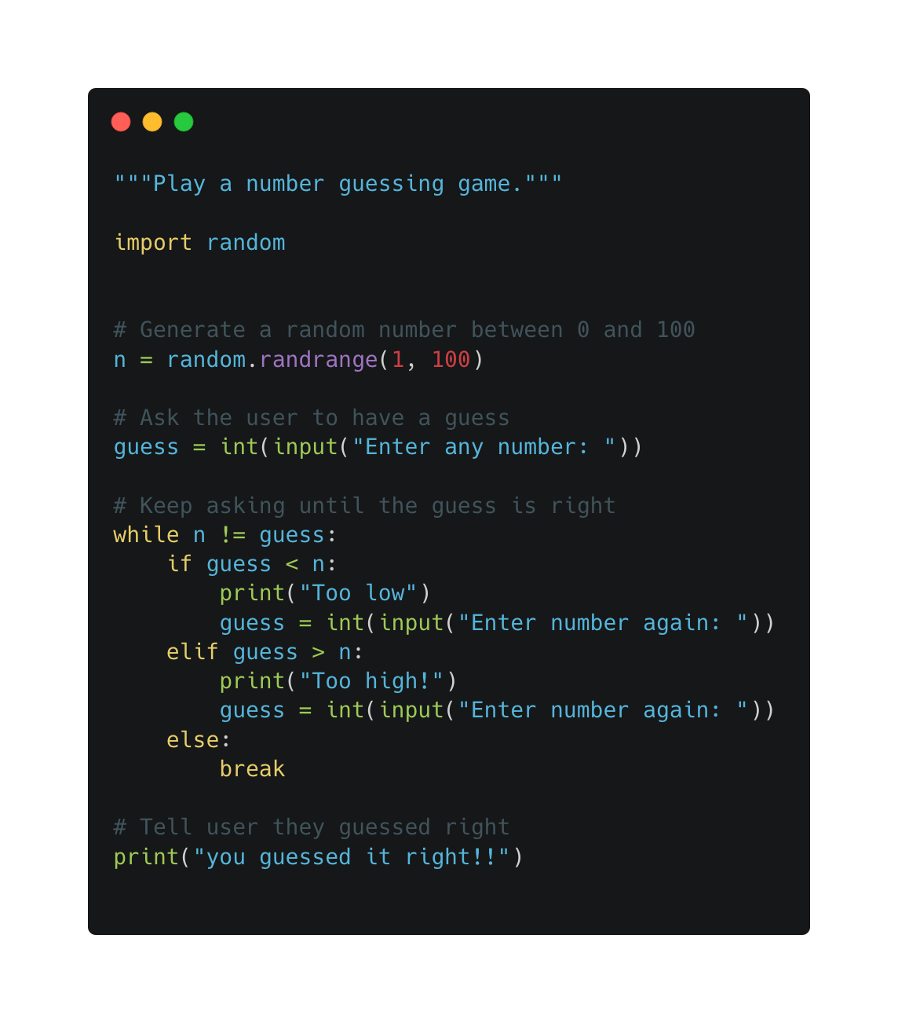
Python
Example programs
00_number_guessing_game.py
Generate a random number between 1 and 100
Ask the user to guess the number
Inform the user whether their guess was too high or too low
Repeat process until the guess is correct

Slide 16
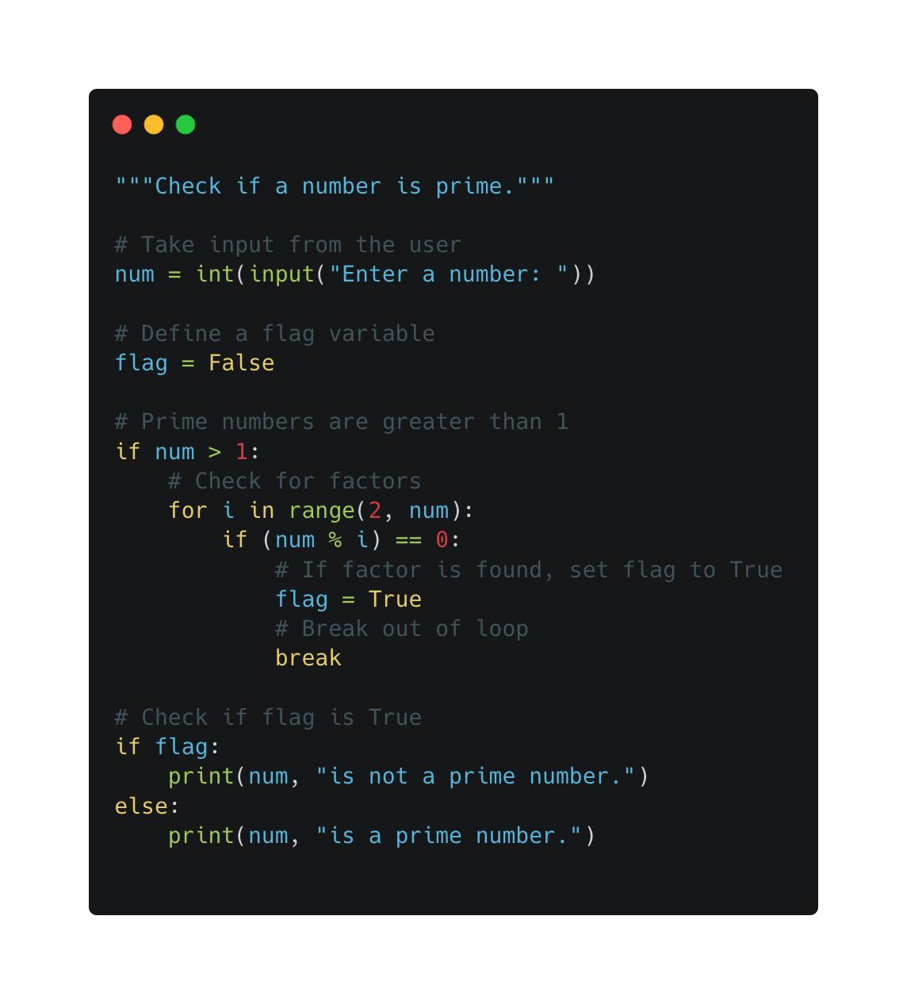
Python
Example programs
00_check_prime_number.py
Ask user to input a number
Check if the number has a factor other than 1 and itself
Report whether the number is prime

Slide 17
Python
What is it used for?
Web development
e.g., Dropbox, Google, Spotify, Instagram, Netflix, Uber, Reddit
AI and machine learning
e.g., Google, Facebook, AstraZeneca, Exscientia
Data analytics and visualization
e.g., Universities, businesses, tech startups
Game development
e.g., World of Tanks, Sims 4, Battelfield II, Civilization IV
Finance
e.g., OpenBB, cryptocurrency, banking software

Slide 18
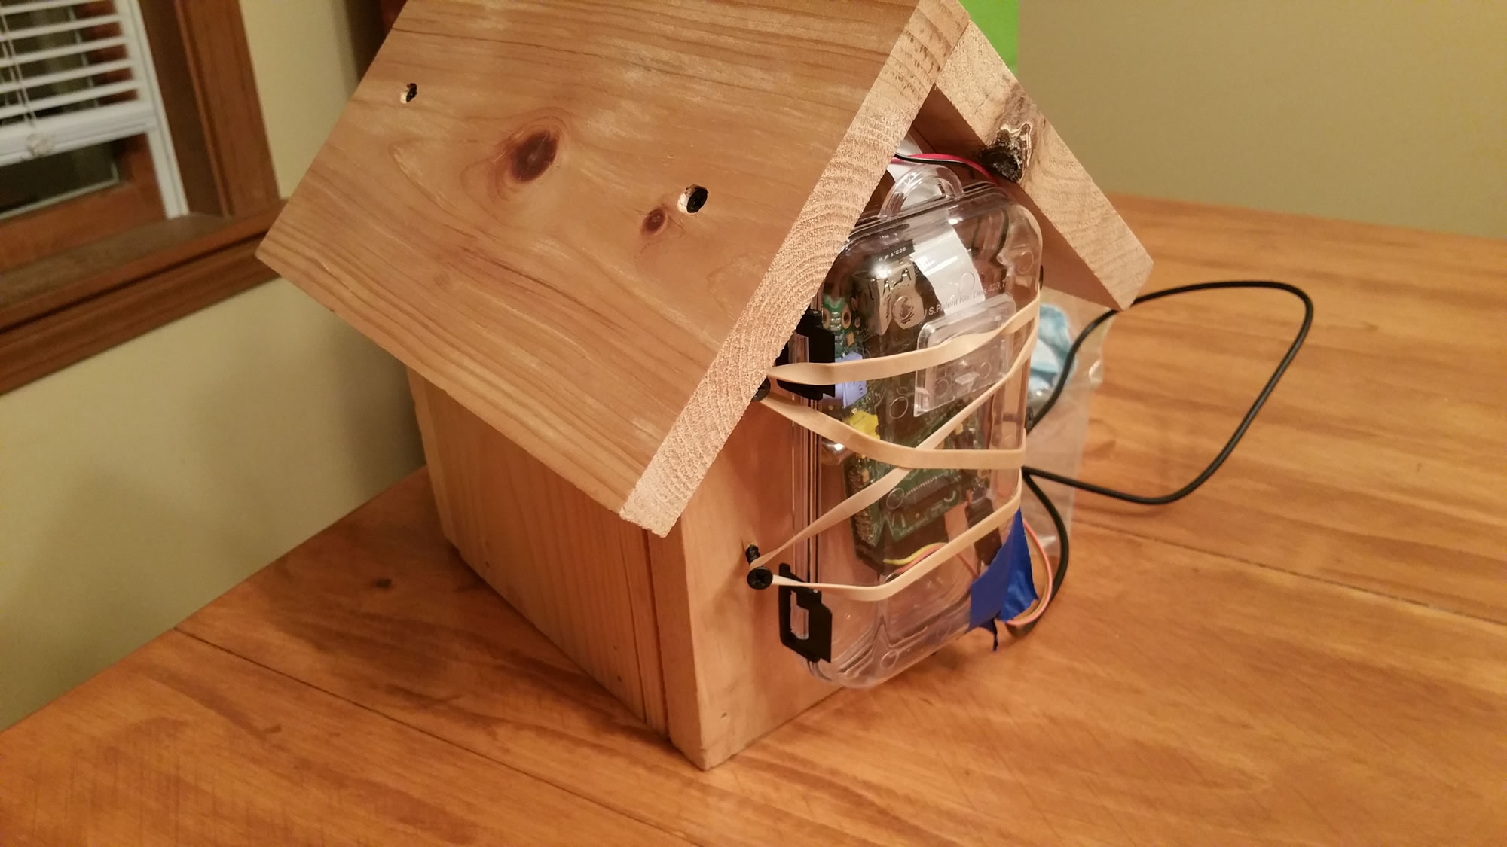
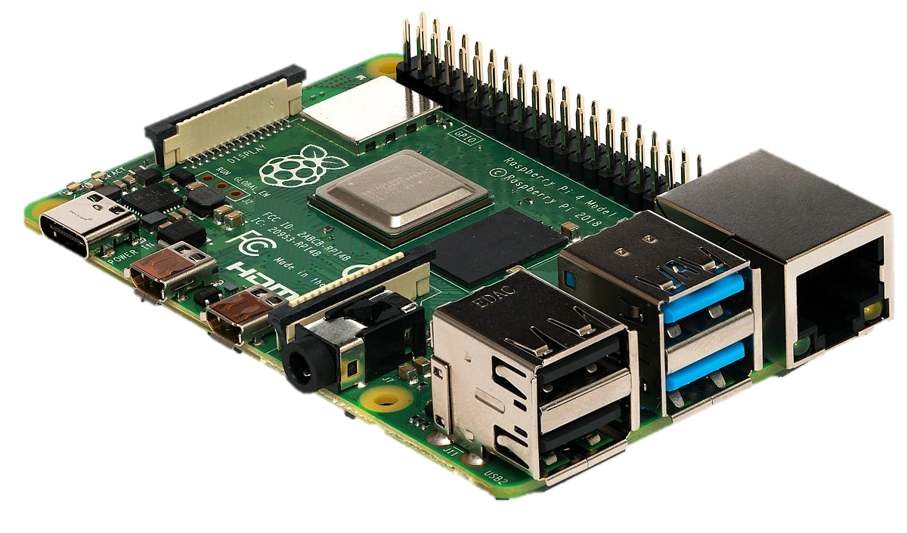
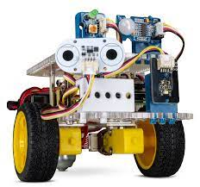
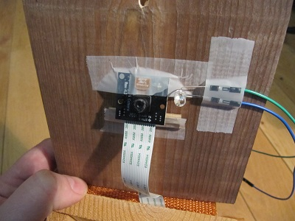
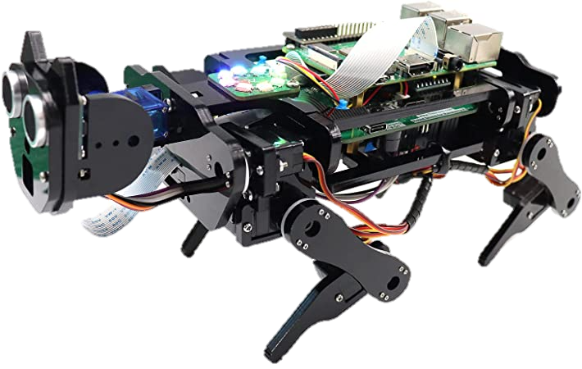

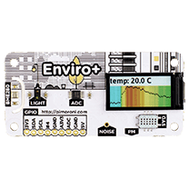
Python
What is it used for?
Hobbies
Raspberry Pi microcomputer
Robots and robotic arms
Wildlife cameras
Environmental sensors
Home automation

Slide 19

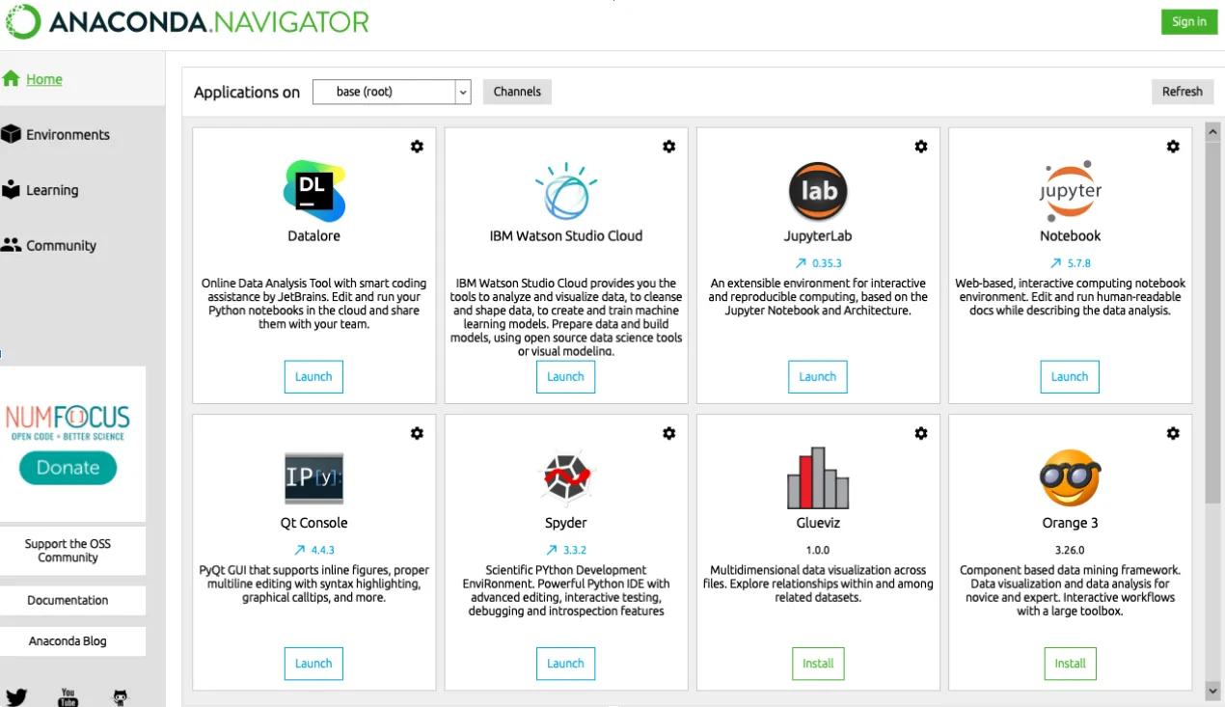
Python
How do we install it?
A free and open-source data science platform for Python.
There are many options
Download an official distribution from python.org
Install from a package manager (apt, homebrew, etc.)
Build from source code
Install from the Microsoft store
We will complete installation using the Anaconda distribution
Anaconda is a popular platform for doing scientific computing and data science with Python
Notes:
Note: You can also complete the installation on Windows using alternative distributions, such as Anaconda, but this tutorial covers only official distributions.
Anaconda is a popular platform for doing scientific computing and data science with Python. To learn how to install Anaconda on Windows, check out Setting Up Python for Machine Learning on Windows.

Slide 20
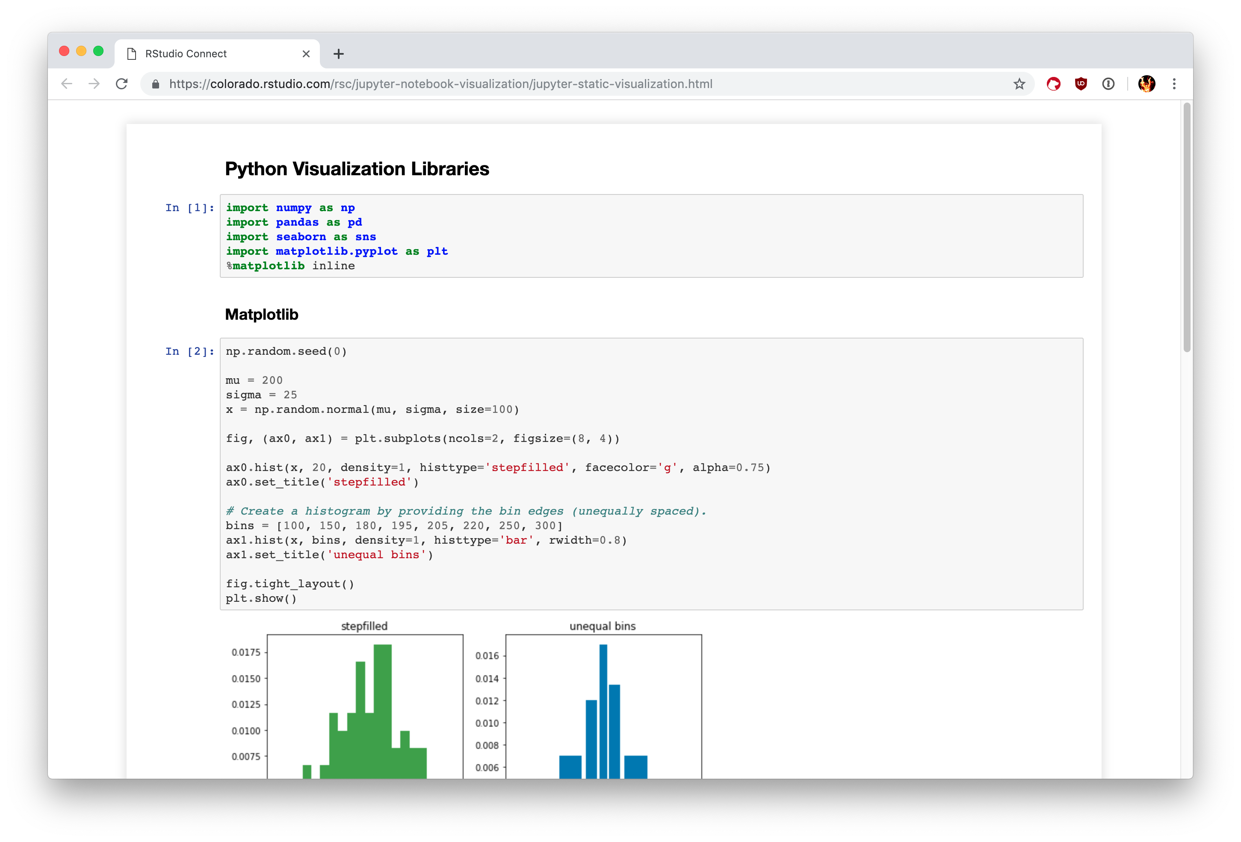
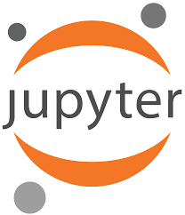
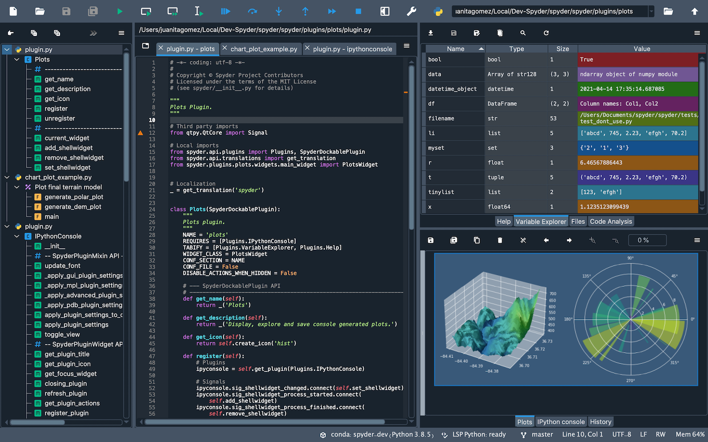

Python
How will we work with it?
Software installed via Anaconda
Jupyter is a web-based interactive development environment for creating and sharing computational documents
Spyder is a free and open-source scientific environment written in Python, for Python, and designed by and for scientists, engineers and data analysts
Notes:
Note: You can also complete the installation on Windows using alternative distributions, such as Anaconda, but this tutorial covers only official distributions.
Anaconda is a popular platform for doing scientific computing and data science with Python. To learn how to install Anaconda on Windows, check out Setting Up Python for Machine Learning on Windows.

Slide 21
Let’s go!
Open this file
notebooks/00_introduction_to_the_python_programming_language.pdf

